Slide 1

Murach's JavaScript and jQuery, C7
© 2012, Mike Murach & Associates, Inc.
Slide <number>

Slide 2
Objectives
Over the next couple of class periods I’m going to introduce you to JQuery.
  What is JQuery?
  How do you add JQuery to a web page?
  Several Examples
    First in JavaScript
    Then in JQuery
    Maybe a little JQuery UI
By the end of the topic you’ll be able to look at JQuery examples and figure out how they work enough to be able to add them to your web pages.
Murach's JavaScript and jQuery, C7
© 2012, Mike Murach & Associates, Inc.
Slide <number>

Slide 3
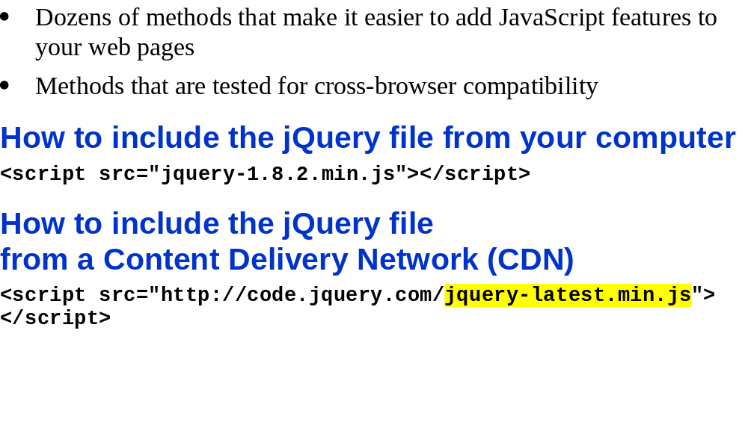
What jQuery offers
Murach's JavaScript and jQuery, C7
© 2012, Mike Murach & Associates, Inc.
Slide <number>

Slide 4
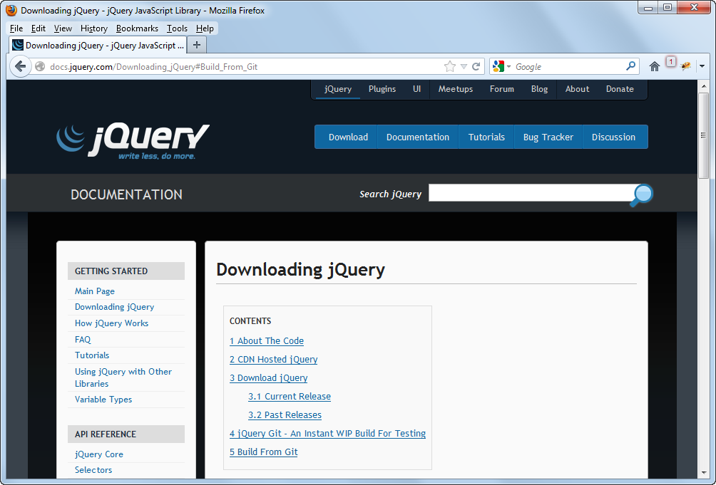
The jQuery web site at www.jQuery.com
Murach's JavaScript and jQuery, C7
© 2012, Mike Murach & Associates, Inc.
Slide <number>

Slide 5
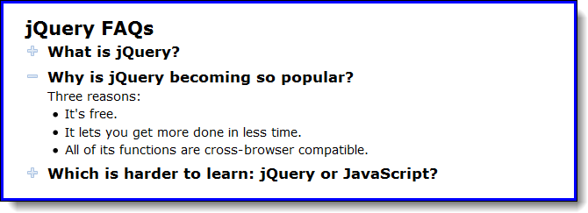
The user interface for the FAQs application
Murach's JavaScript and jQuery, C7
© 2012, Mike Murach & Associates, Inc.
Slide <number>

Slide 6
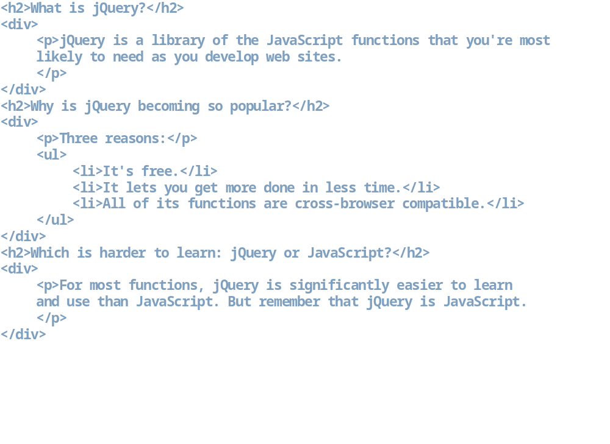
The HTML for the FAQs application
Murach's JavaScript and jQuery, C7
© 2012, Mike Murach & Associates, Inc.
Slide <number>

Slide 7
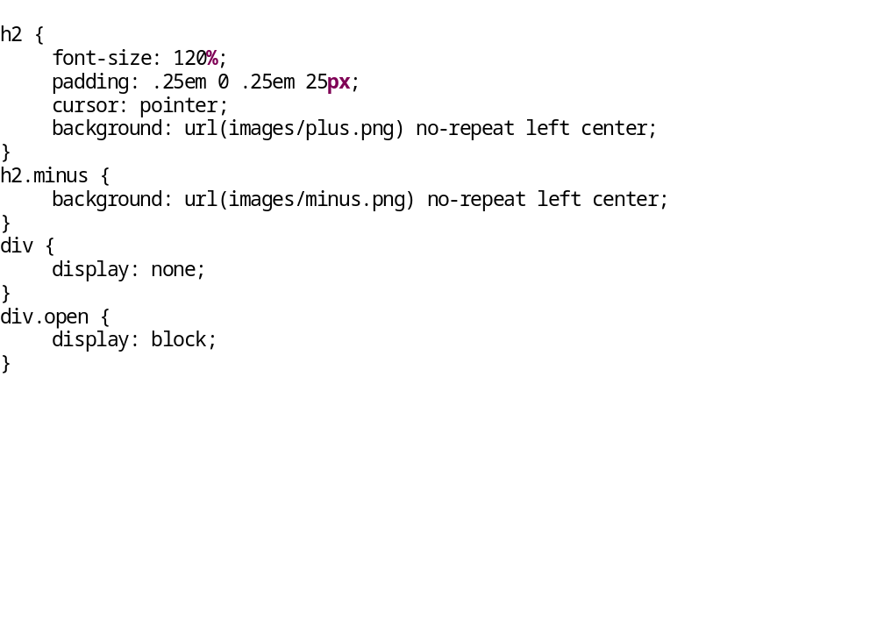
The CSS for the FAQs application
Murach's JavaScript and jQuery, C7
© 2012, Mike Murach & Associates, Inc.
Slide <number>

Slide 8
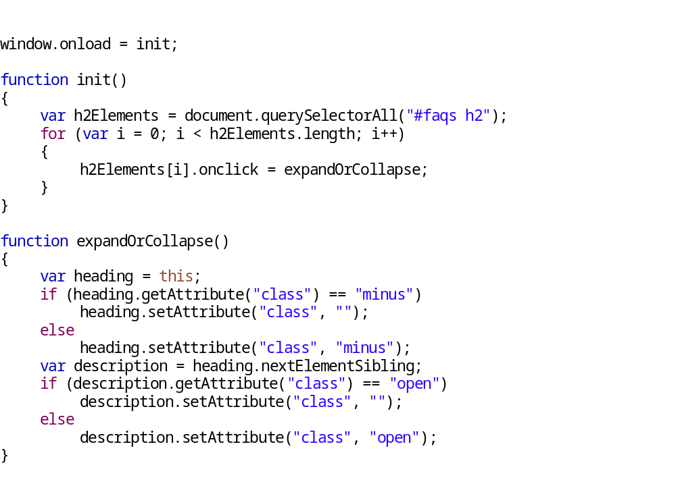
The JavaScript for the FAQs application
Murach's JavaScript and jQuery, C7
© 2012, Mike Murach & Associates, Inc.
Slide <number>

Slide 9
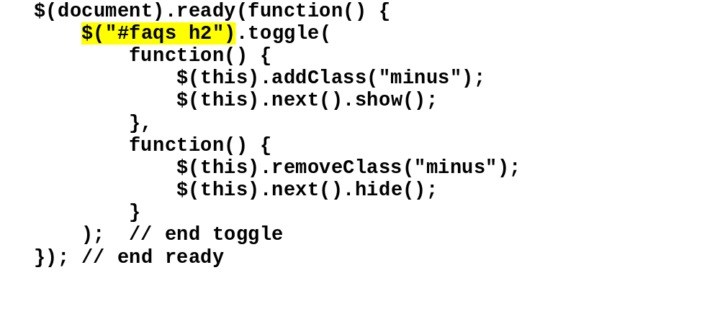
The jQuery for the FAQs application
Murach's JavaScript and jQuery, C7
© 2012, Mike Murach & Associates, Inc.
Slide <number>

Slide 10
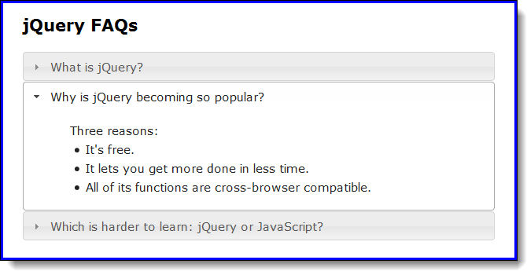
The FAQs application as a jQuery UI accordion
Murach's JavaScript and jQuery, C7
© 2012, Mike Murach & Associates, Inc.
Slide <number>

Slide 11
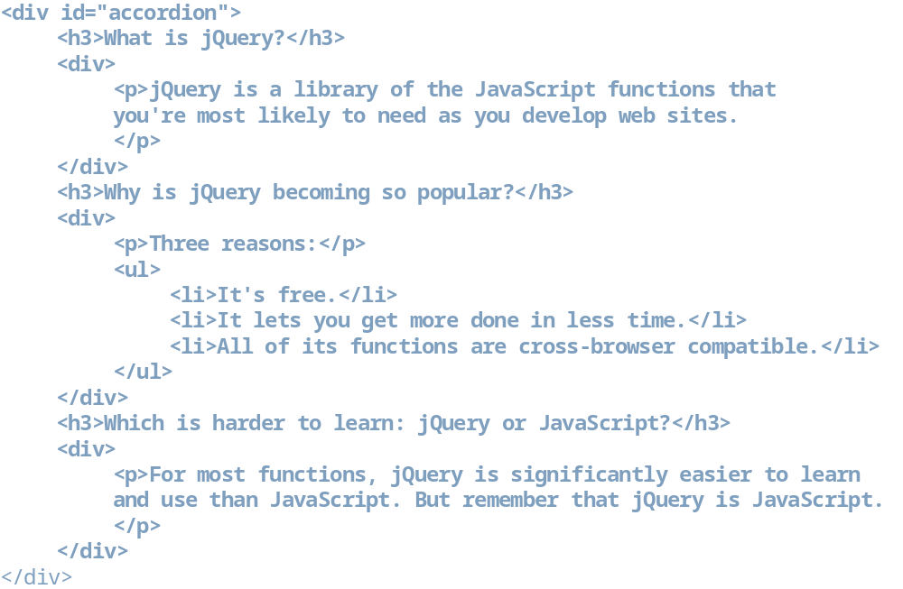
The HTML for a jQuery UI accordion
Murach's JavaScript and jQuery, C7
© 2012, Mike Murach & Associates, Inc.
Slide <number>

Slide 12
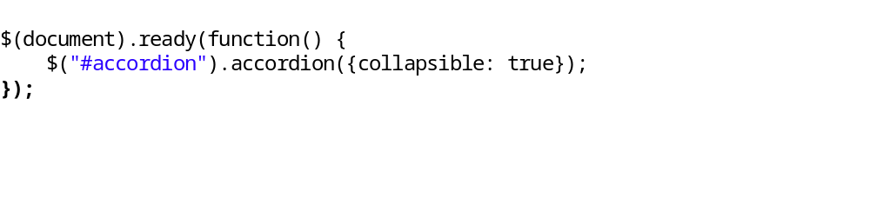
The JavaScript code for the jQuery UI accordion
Murach's JavaScript and jQuery, C7
© 2012, Mike Murach & Associates, Inc.
Slide <number>

Slide 13
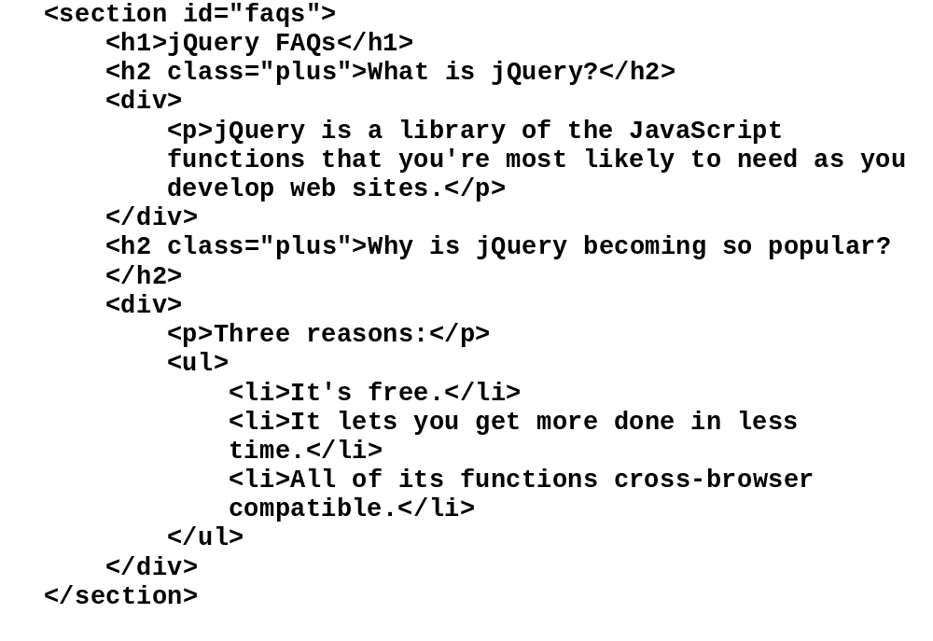
The HTML for the selected elements
Murach's JavaScript and jQuery, C7
© 2012, Mike Murach & Associates, Inc.
Slide <number>

Slide 14
The syntax for a jQuery selector
Murach's JavaScript and jQuery, C7
© 2012, Mike Murach & Associates, Inc.
Slide <number>

Slide 15
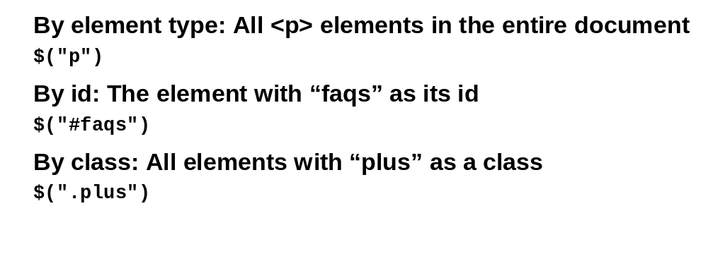
How to select elements by element, id, and class
Murach's JavaScript and jQuery, C7
© 2012, Mike Murach & Associates, Inc.
Slide <number>

Slide 16
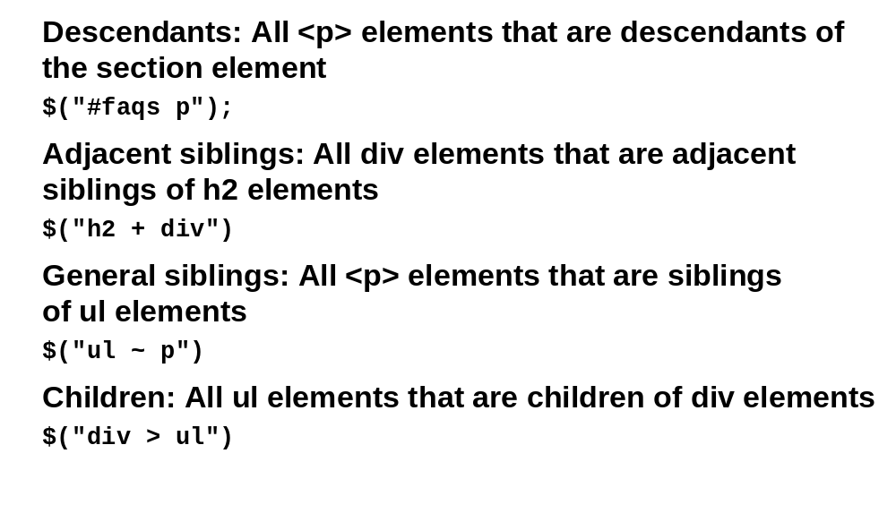
How to select elements by relationship
Murach's JavaScript and jQuery, C7
© 2012, Mike Murach & Associates, Inc.
Slide <number>

Slide 17
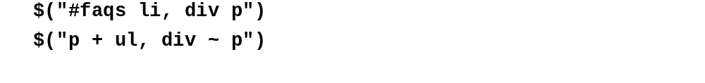
How to code multiple selectors
Murach's JavaScript and jQuery, C7
© 2012, Mike Murach & Associates, Inc.
Slide <number>

Slide 18
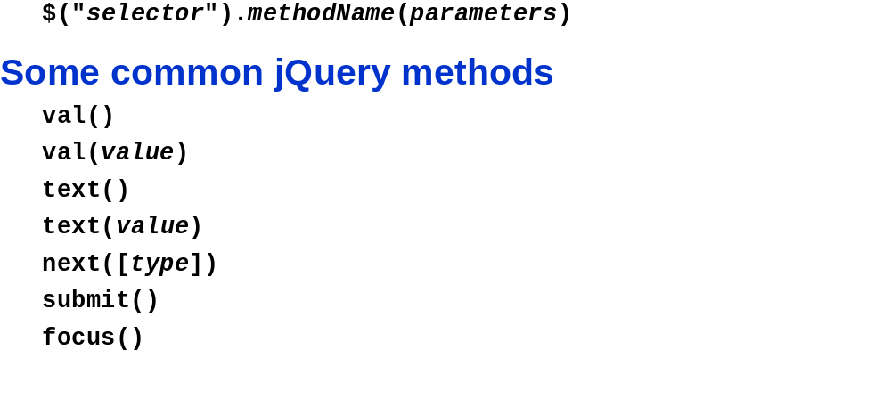
The syntax for calling a jQuery method
Murach's JavaScript and jQuery, C7
© 2012, Mike Murach & Associates, Inc.
Slide <number>

Slide 19
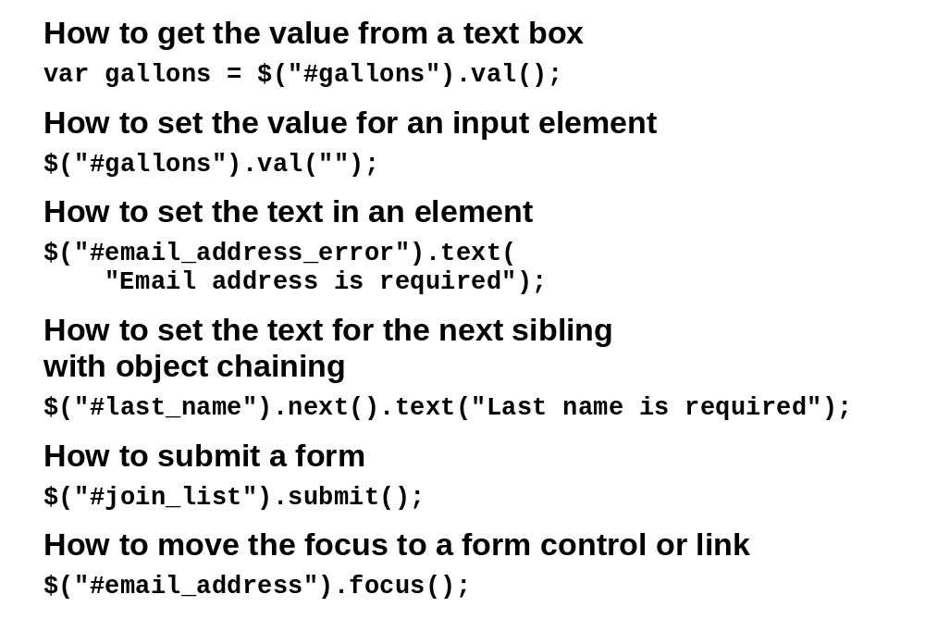
Examples that call jQuery methods
Murach's JavaScript and jQuery, C7
© 2012, Mike Murach & Associates, Inc.
Slide <number>

Slide 20
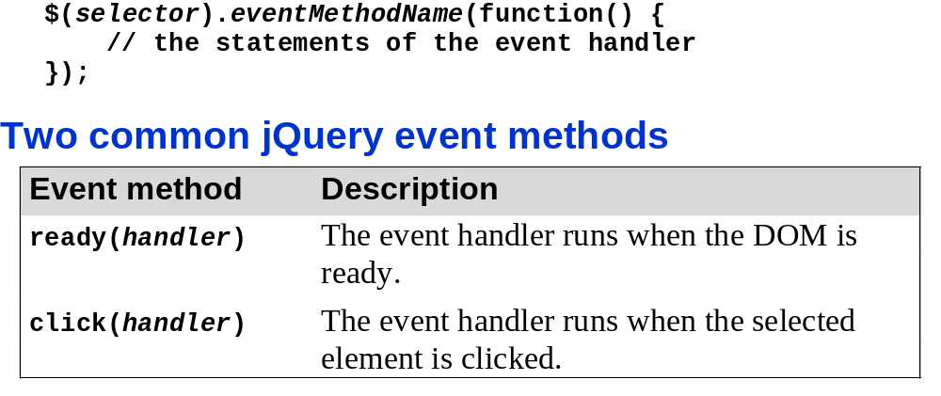
The syntax for a jQuery event method
Murach's JavaScript and jQuery, C7
© 2012, Mike Murach & Associates, Inc.
Slide <number>

Slide 21
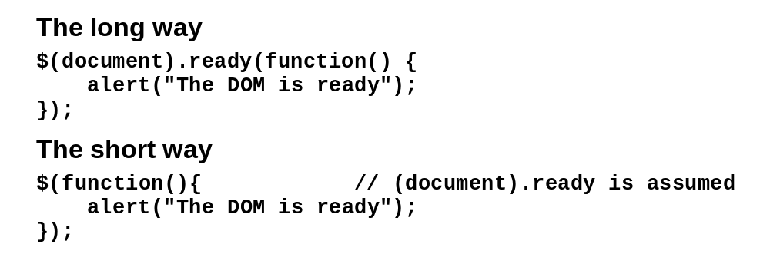
How to code an event handler for the ready event
Murach's JavaScript and jQuery, C7
© 2012, Mike Murach & Associates, Inc.
Slide <number>

Slide 22
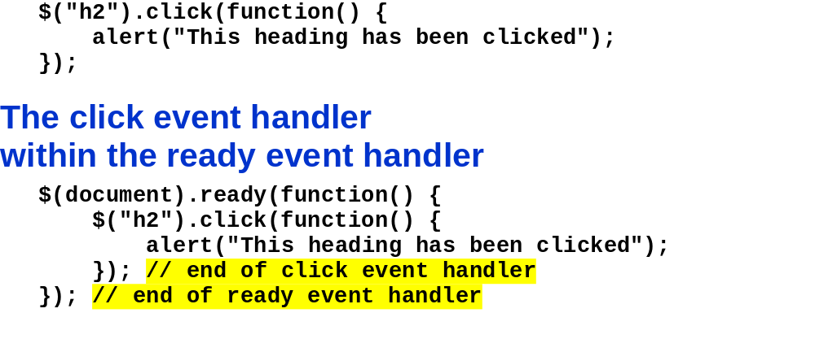
An event handler for the click event of all h2 elements
Murach's JavaScript and jQuery, C7
© 2012, Mike Murach & Associates, Inc.
Slide <number>

Slide 23
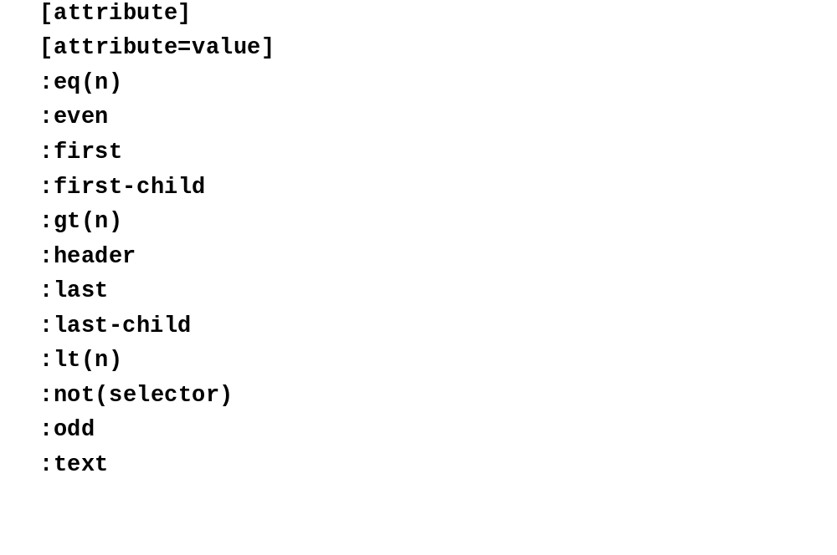
Some of the most useful jQuery selectors
Murach's JavaScript and jQuery, C7
© 2012, Mike Murach & Associates, Inc.
Slide <number>

Slide 24
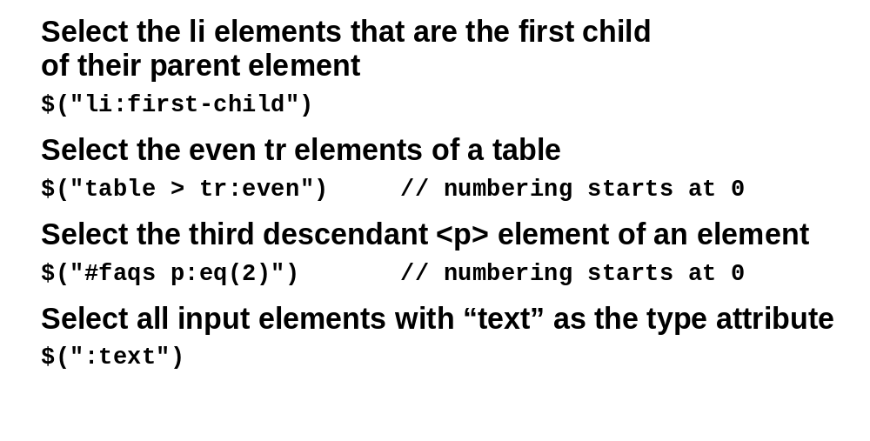
Examples that use jQuery selectors
Murach's JavaScript and jQuery, C7
© 2012, Mike Murach & Associates, Inc.
Slide <number>

Slide 25
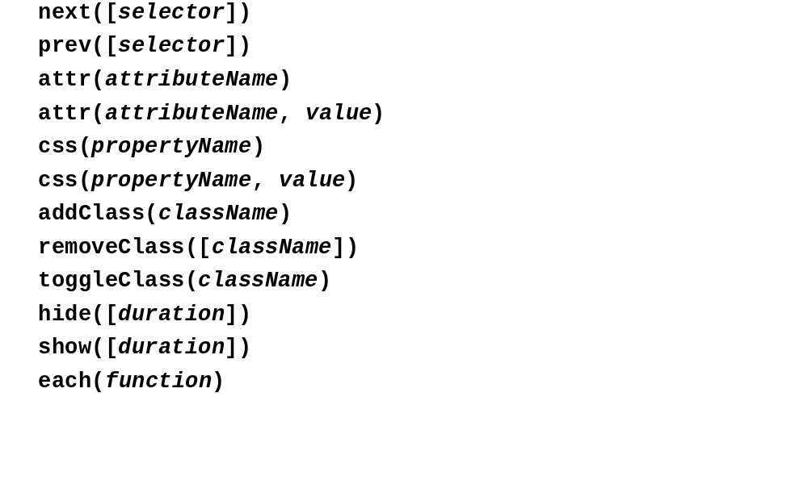
A summary of the most useful jQuery methods
Murach's JavaScript and jQuery, C7
© 2012, Mike Murach & Associates, Inc.
Slide <number>

Slide 26
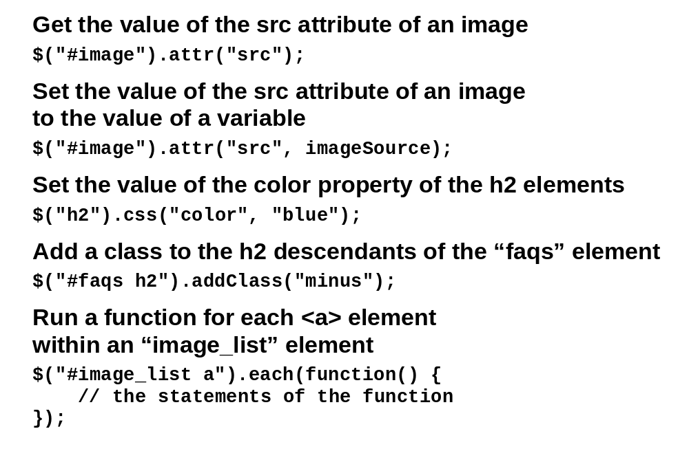
Examples that use jQuery methods
Murach's JavaScript and jQuery, C7
© 2012, Mike Murach & Associates, Inc.
Slide <number>

Slide 27
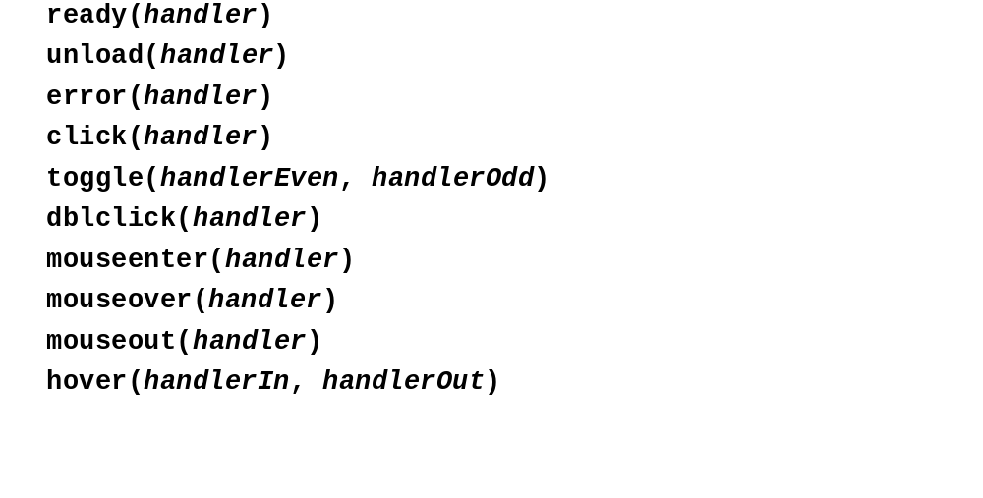
Some of the most useful jQuery event methods
Murach's JavaScript and jQuery, C7
© 2012, Mike Murach & Associates, Inc.
Slide <number>

Slide 28
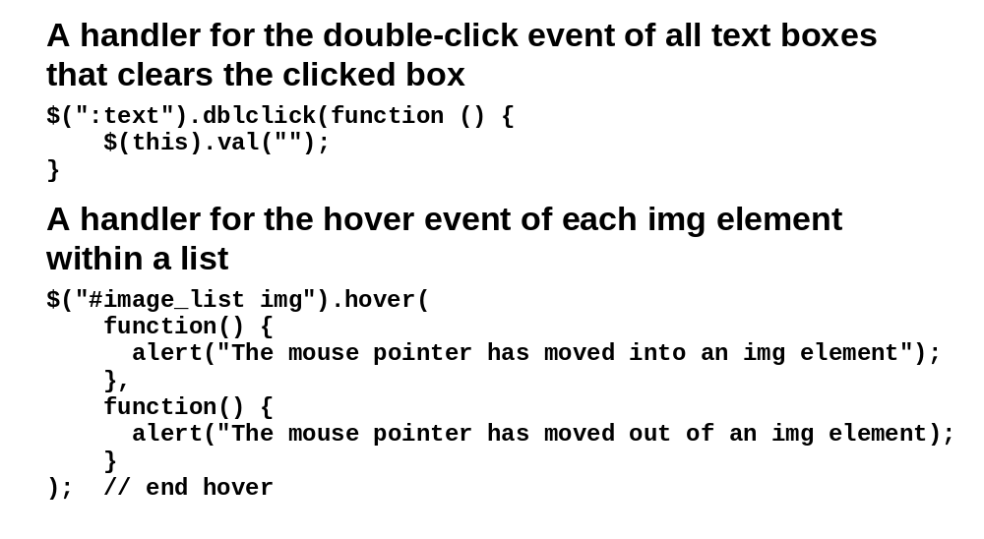
Examples that use jQuery event methods
Murach's JavaScript and jQuery, C7
© 2012, Mike Murach & Associates, Inc.
Slide <number>

Slide 29
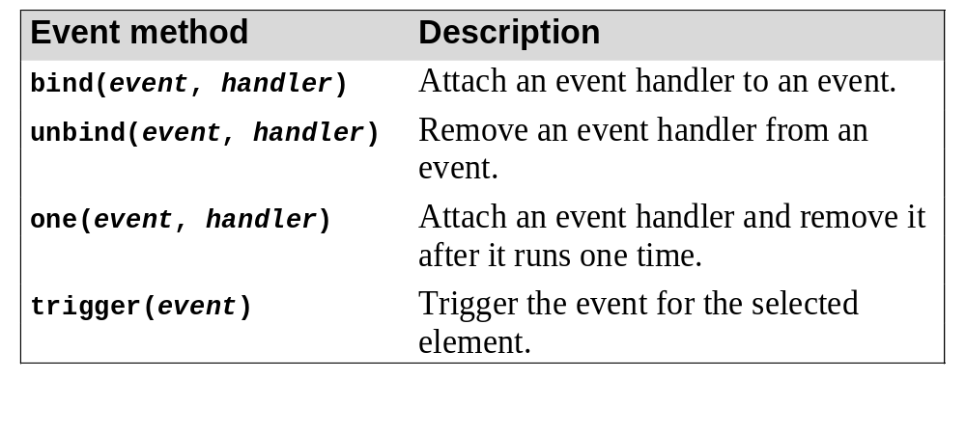
Other event methods that you should be aware of
Murach's JavaScript and jQuery, C7
© 2012, Mike Murach & Associates, Inc.
Slide <number>

Slide 30
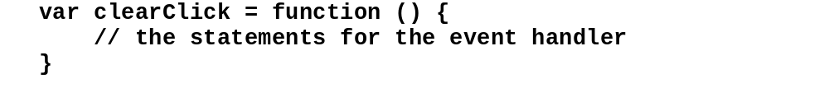
How to store an event handler in a variable
Murach's JavaScript and jQuery, C7
© 2012, Mike Murach & Associates, Inc.
Slide <number>

Slide 31
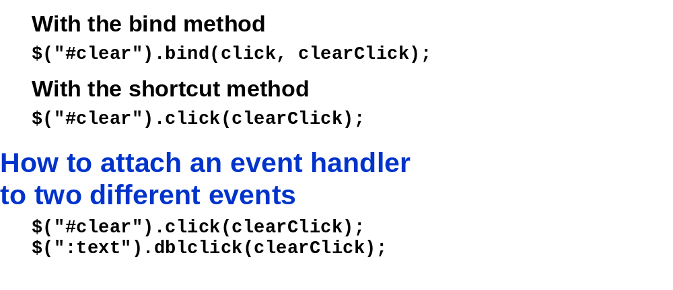
How to attach an event handler to an event
Murach's JavaScript and jQuery, C7
© 2012, Mike Murach & Associates, Inc.
Slide <number>

Slide 32
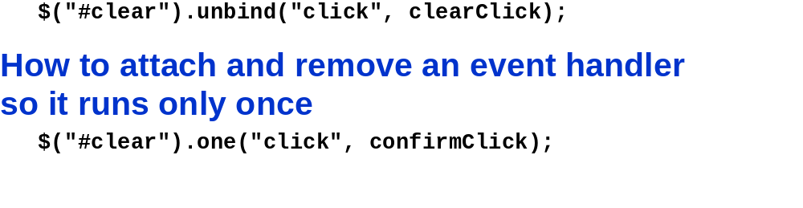
How to remove an event handler from an event
Murach's JavaScript and jQuery, C7
© 2012, Mike Murach & Associates, Inc.
Slide <number>

Slide 33
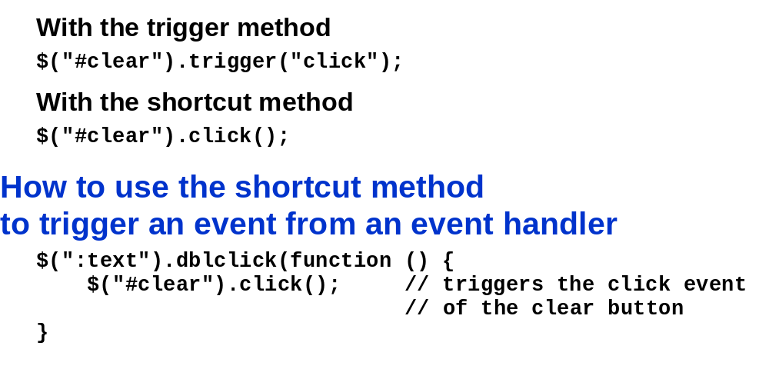
How to trigger an event
Murach's JavaScript and jQuery, C7
© 2012, Mike Murach & Associates, Inc.
Slide <number>

Slide 34
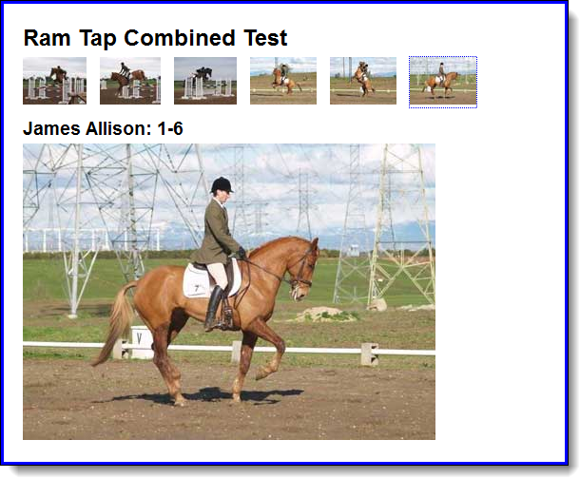
The user interface for the Image Swap application
Murach's JavaScript and jQuery, C7
© 2012, Mike Murach & Associates, Inc.
Slide <number>

Slide 35
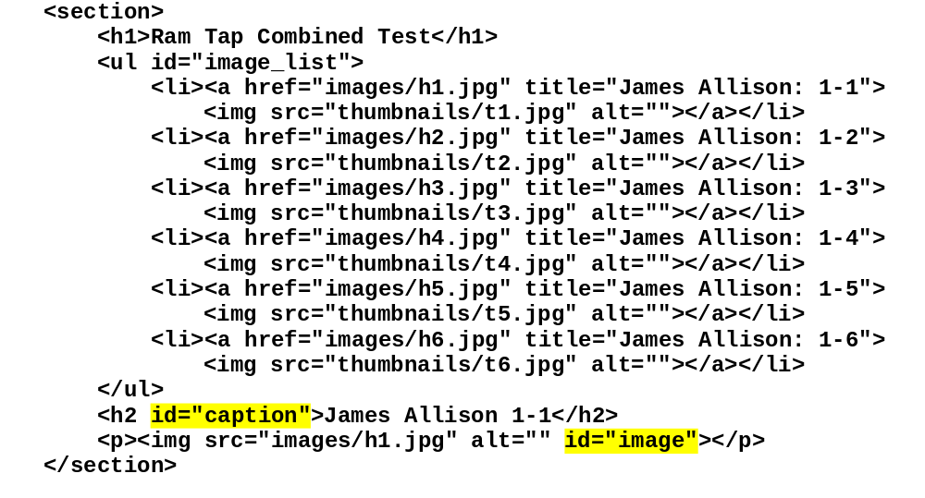
The HTML for the Image Swap application
Murach's JavaScript and jQuery, C7
© 2012, Mike Murach & Associates, Inc.
Slide <number>

Slide 36
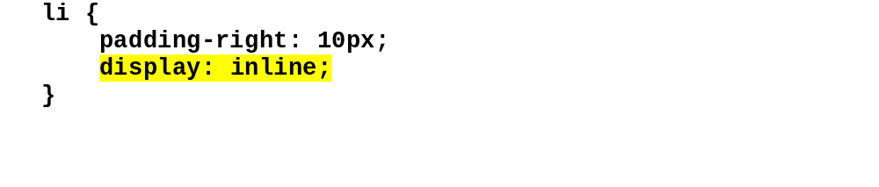
The CSS for the li elements
Murach's JavaScript and jQuery, C7
© 2012, Mike Murach & Associates, Inc.
Slide <number>

Slide 37
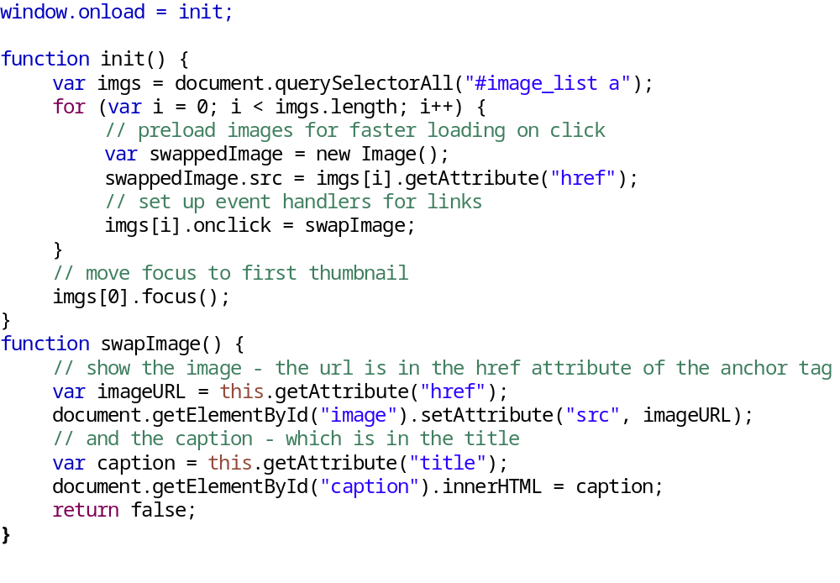
The JavaScript for the Image Swap application
Murach's JavaScript and jQuery, C7
© 2012, Mike Murach & Associates, Inc.
Slide <number>

Slide 38
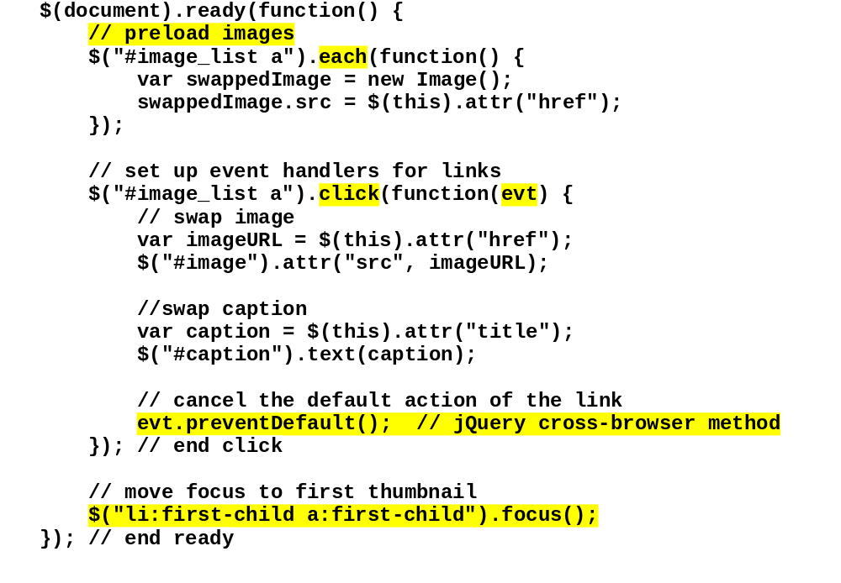
The JQuery for the Image Swap application
Murach's JavaScript and jQuery, C7
© 2012, Mike Murach & Associates, Inc.
Slide <number>

Slide 39
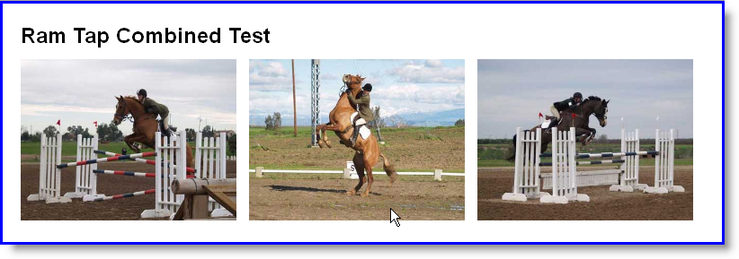
Three images with the middle image rolled over
Murach's JavaScript and jQuery, C7
© 2012, Mike Murach & Associates, Inc.
Slide <number>

Slide 40
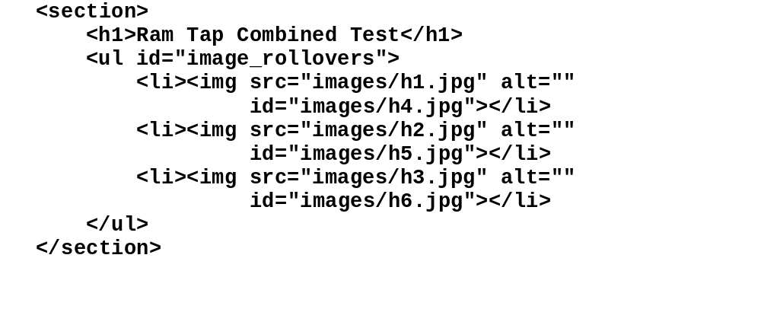
The HTML for the Image Rollover application
Murach's JavaScript and jQuery, C7
© 2012, Mike Murach & Associates, Inc.
Slide <number>

Slide 41
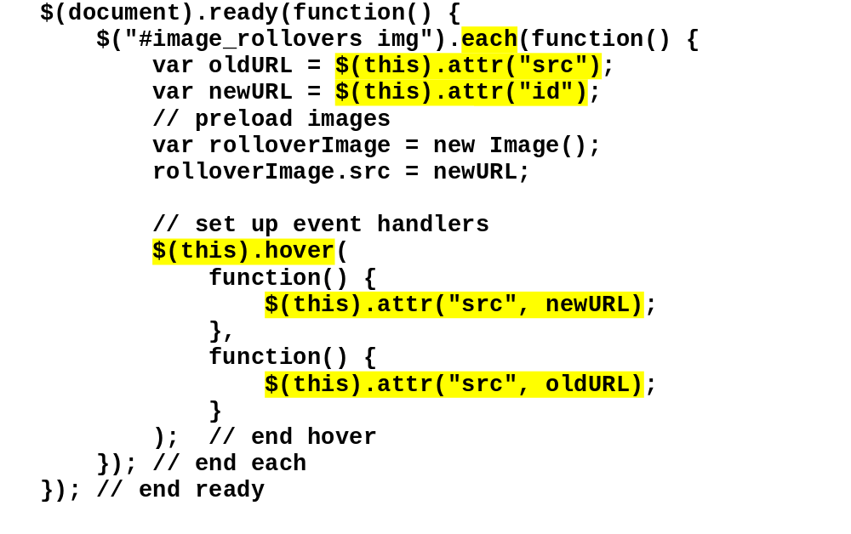
The JavaScript for the Image Rollover application
Murach's JavaScript and jQuery, C7
© 2012, Mike Murach & Associates, Inc.
Slide <number>

Slide 42
The JQuery for the Image Rollover application
Murach's JavaScript and jQuery, C7
© 2012, Mike Murach & Associates, Inc.
Slide <number>

Slide 43
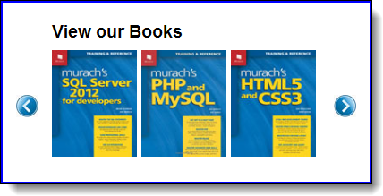
A Carousel application
Murach's JavaScript and jQuery, C8
© 2012, Mike Murach & Associates, Inc.
Slide <number>

Slide 44
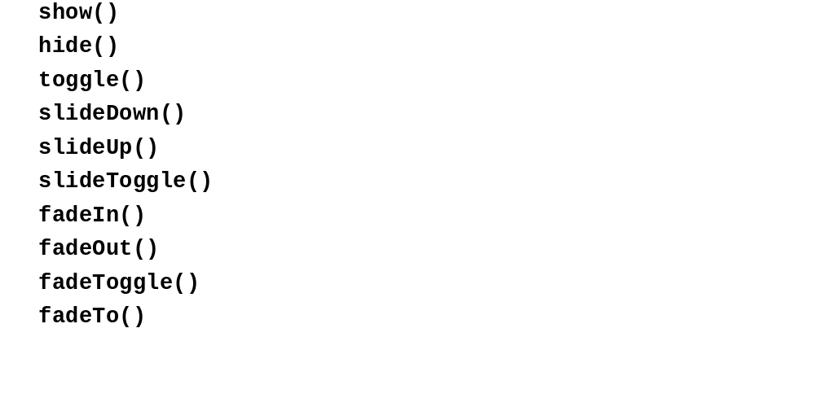
The basic methods for jQuery effects
Murach's JavaScript and jQuery, C8
© 2012, Mike Murach & Associates, Inc.
Slide <number>

Slide 45
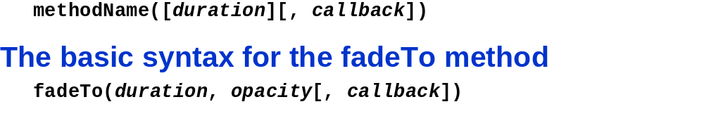
The basic syntax for all of the methods except the fadeTo method
Murach's JavaScript and jQuery, C8
© 2012, Mike Murach & Associates, Inc.
Slide <number>

Slide 46
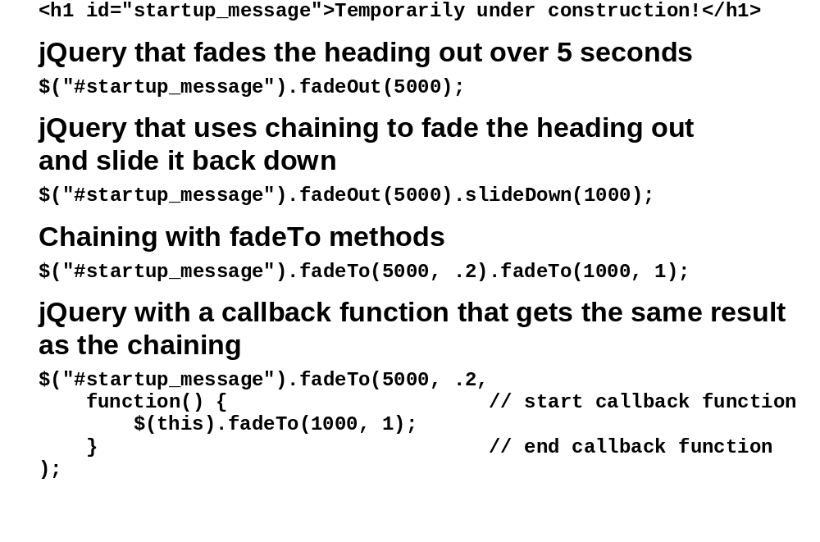
HTML for a heading that is animated after the web page is loaded
Murach's JavaScript and jQuery, C8
© 2012, Mike Murach & Associates, Inc.
Slide <number>

Slide 47
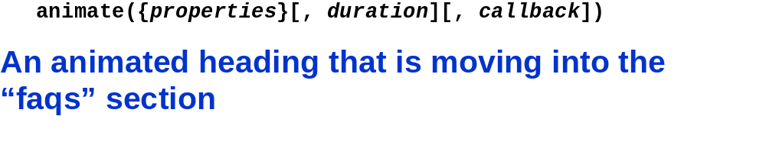
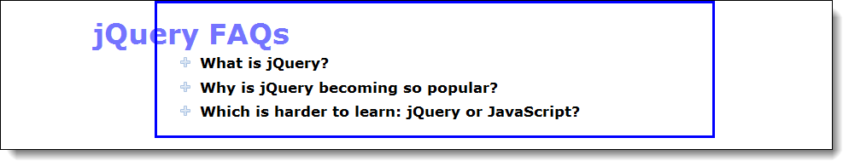
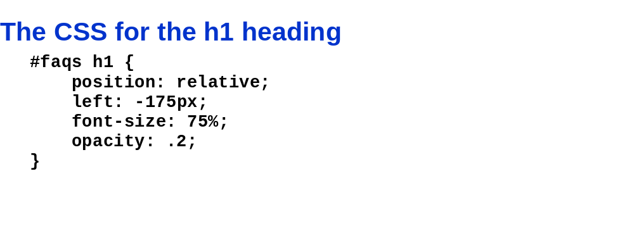
The basic syntax for the animate method
Murach's JavaScript and jQuery, C8
© 2012, Mike Murach & Associates, Inc.
Slide <number>

Slide 48
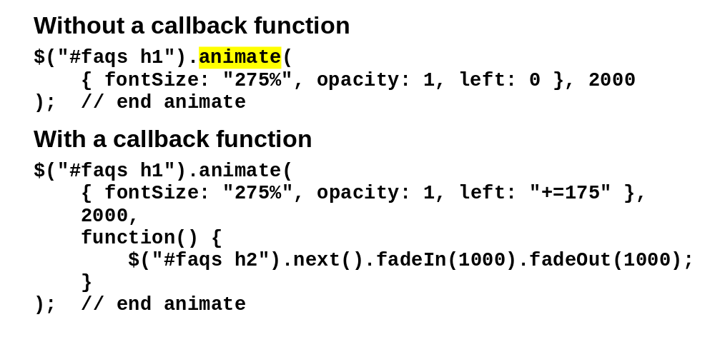
An animate method for the h1 heading
Murach's JavaScript and jQuery, C8
© 2012, Mike Murach & Associates, Inc.
Slide <number>

Slide 49
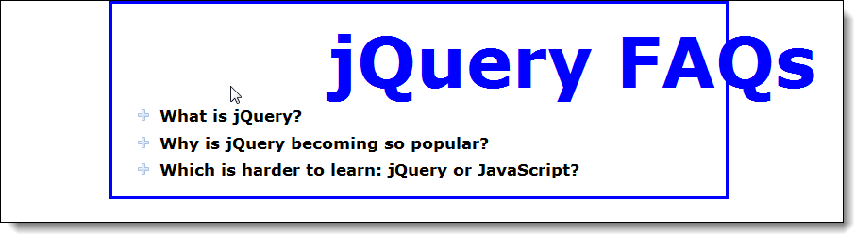
A heading with two animations started by its click event
Murach's JavaScript and jQuery, C8
© 2012, Mike Murach & Associates, Inc.
Slide <number>

Slide 50
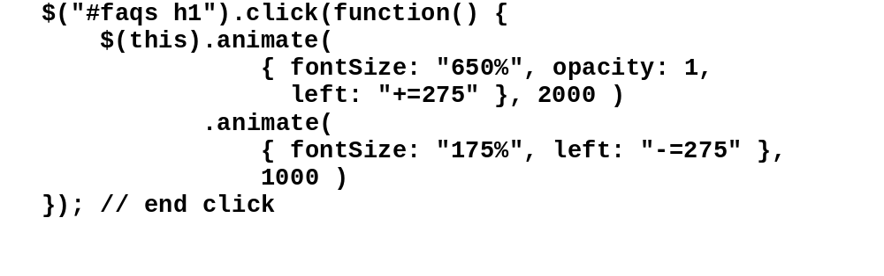
Chained animations
Murach's JavaScript and jQuery, C8
© 2012, Mike Murach & Associates, Inc.
Slide <number>

Slide 51
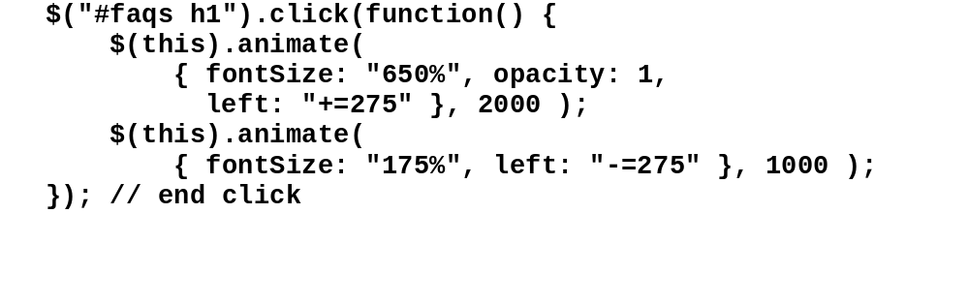
Queued animations
Murach's JavaScript and jQuery, C8
© 2012, Mike Murach & Associates, Inc.
Slide <number>

Slide 52
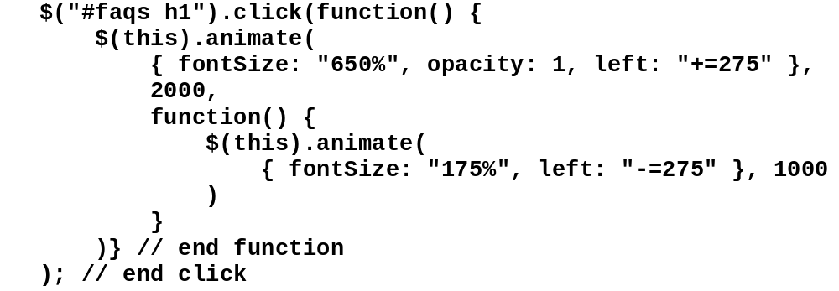
An animation with a second animation in its callback function
Murach's JavaScript and jQuery, C8
© 2012, Mike Murach & Associates, Inc.
Slide <number>

Slide 53

The delay and stop methods
Murach's JavaScript and jQuery, C8
© 2012, Mike Murach & Associates, Inc.
Slide <number>

Slide 54

HTML for a heading that is displayed when the web page is loaded
Murach's JavaScript and jQuery, C8
© 2012, Mike Murach & Associates, Inc.
Slide <number>

Slide 55

Stopping the queued animations before starting a new one
Murach's JavaScript and jQuery, C8
© 2012, Mike Murach & Associates, Inc.
Slide <number>

Slide 56

The syntax for using easing with effects and animations
Murach's JavaScript and jQuery, C8
© 2012, Mike Murach & Associates, Inc.
Slide <number>

Slide 57

A script element for getting the jQuery UI library from the Google CDN
Murach's JavaScript and jQuery, C8
© 2012, Mike Murach & Associates, Inc.
Slide <number>

Slide 58

The advanced syntax for the animate method
Murach's JavaScript and jQuery, C8
© 2012, Mike Murach & Associates, Inc.
Slide <number>

Slide 59

An animate method with the advanced syntax
Murach's JavaScript and jQuery, C8
© 2012, Mike Murach & Associates, Inc.
Slide <number>

Slide 60

How to provide easings by property with the basic syntax
Murach's JavaScript and jQuery, C8
© 2012, Mike Murach & Associates, Inc.
Slide <number>

Slide 61

The methods for working with animation queues
Murach's JavaScript and jQuery, C8
© 2012, Mike Murach & Associates, Inc.
Slide <number>

Slide 62

The HTML for the Carousel application
Murach's JavaScript and jQuery, C8
© 2012, Mike Murach & Associates, Inc.
Slide <number>

Slide 63

The HTML for the Carousel application (cont.)
Murach's JavaScript and jQuery, C8
© 2012, Mike Murach & Associates, Inc.
Slide <number>

Slide 64

The critical CSS for the Carousel application
Murach's JavaScript and jQuery, C8
© 2012, Mike Murach & Associates, Inc.
Slide <number>

Slide 65

The jQuery for the Carousel application
Murach's JavaScript and jQuery, C8
© 2012, Mike Murach & Associates, Inc.
Slide <number>

Slide 66

The jQuery for the Carousel application (cont.)
Murach's JavaScript and jQuery, C8
© 2012, Mike Murach & Associates, Inc.
Slide <number>

Slide 67

Lab 8 – Translate Hanjie to JQuery Syntax
Murach's JavaScript and jQuery, C7
© 2012, Mike Murach & Associates, Inc.
Slide <number>

Slide 68

What’s Next?
Murach's JavaScript and jQuery, C7
© 2012, Mike Murach & Associates, Inc.
Slide <number>

